Slide 1
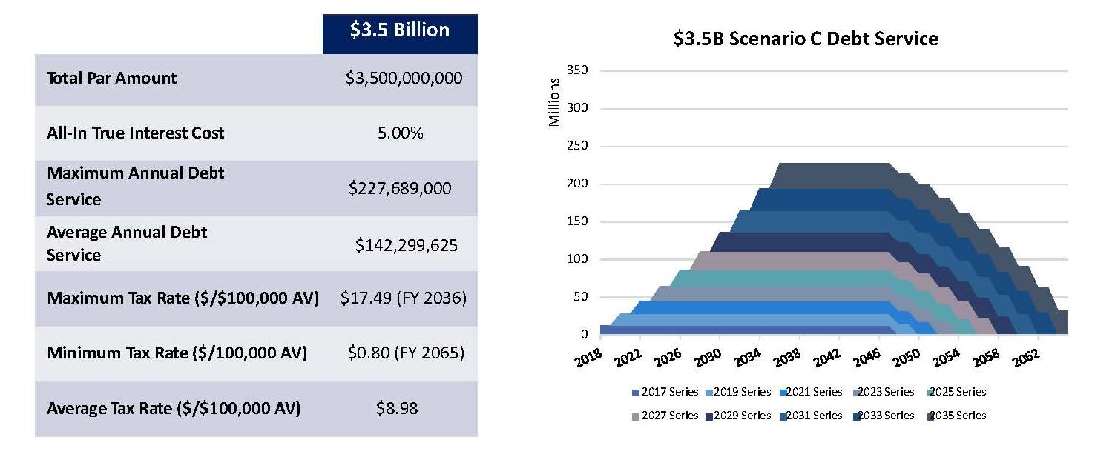
Bond Financing
$3.5 Billion Scenario C – 4% Annual Average Increase

